Slide 1
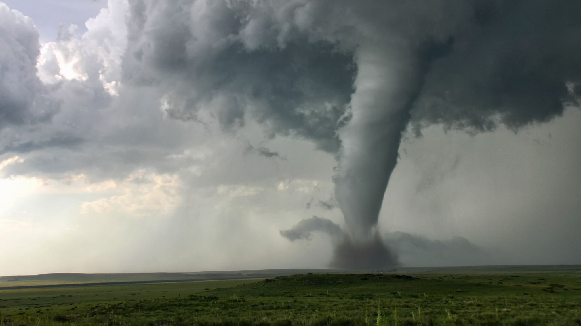
WEATHER PREDICTION
Using Machine Learning

Slide 2

AZENDA
Motivation
Objectives
Problem Survey
Subject Knowledge
Methodology
TimeLine

Slide 3
Motivation
Now a day's weather predicting results are not in accurate. To make this possible AI and ML are the best technologies in prediction.
Machine Learning speed up tasks that can be intensive to compute, such as predicting how water vapor gets converted to rain, snow or hail. It combines all together

Slide 4
Objectives
The main objective of this project is to design a weather prediction model. Most of the fields are influenced by the weather only.
We can extend our scope to provide regional guidelines to farmers, Navy officers, Astronaut and so on.,. depending upon the classification done.

Slide 5
Problem Survey
Related works done by Authors | Objective | Pros | Cons
Yash Mali ¹, Aarya Kurlekar ², Shambhavi Lalsinge ³ | As compared to Linear Regression and SVM, SVM gave the best accuracy rate for the polynomial kernel. | SVMs can use a kernel trick for the data classification. | SVM is difficulty in handling noisy data and take longer to train.
Ismaila Oshodi | Among 4 classifier algorithms, the Gaussian Naive Bayes(GNB) gave the best predictive accuracy rate | GNB trained very efficiently and are highly scalable and can handle both binary and continuous data: | NB assumes that the features are conditionally independent which leads to suboptimal performance.

Slide 6
Problem Survey
Relatable work done by Authors | Objective | Pro's | Con's
Shivam Tandon, Pawan Kumar Singh, Abhishek Patel | The purpose is to format effective weather forecasts and comparison of various machine learning models for forecasting. | It is useful if we have unanticipated values to consider | If we make a single extremely bad prediction, squaring may amplify the error and can skew the metrics.

Slide 7
Subject Knowledge
Data science: Machine learning algorithms require data science skills such as data collection, data cleaning, data processing, and data analysis to be applied effectively.
Machine learning: To apply machine learning algorithms effectively, knowledge of machine learning concepts such as supervised learning, unsupervised learning, and deep learning is required.
Statistics: As machine learning models typically involve statistical techniques such as regression analysis and time-series analysis.
Programming: Proficiency in a programming language such as Python or R is necessary for implementing machine learning models and analyzing data.

Slide 8
Methodology
The methodology used in this project for the prediction of weather and its classification comprises usage of several machine learning algorithms.
The block diagram depicts the machine learning approaches to the implementation of the project.
Intelligent models can be created using machine learning technologies that are much simpler than conventional physical models. They use less resources and can be run on almost any machine, including mobile devices.

Slide 9
Technologies
Dataset
Python
Google Colab
Importing Required Libraries

Slide 10
Importing Required Libraries in Python
Matplotlib
Seaborn
Scipy
Re
Missingno
Warnings
Pandas

Slide 11
TimeLine
Data Collection and Data Pre-Processing
Data Visualization
Training and Testing the Dataset
Machine Learning Algorithms
Predicted Output

Slide 12
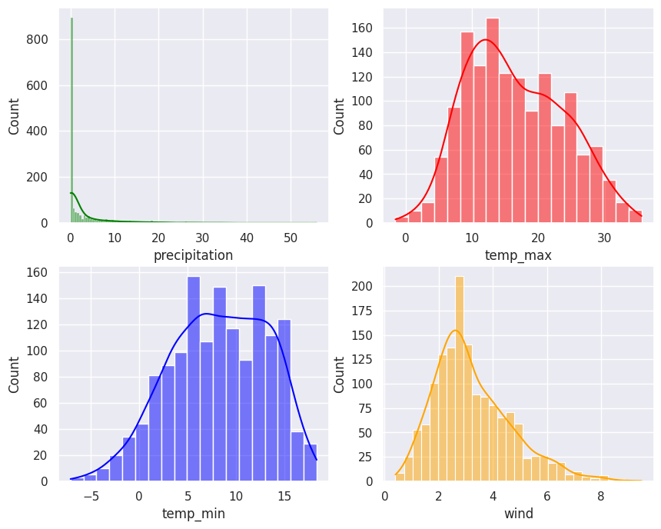
Histplot of Dataset

Slide 13
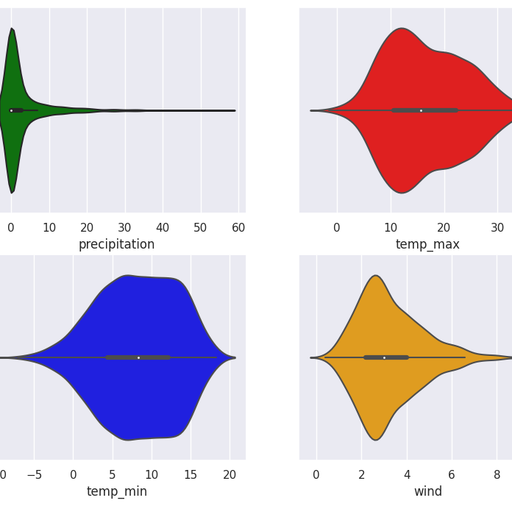
Violin Plot

Slide 14
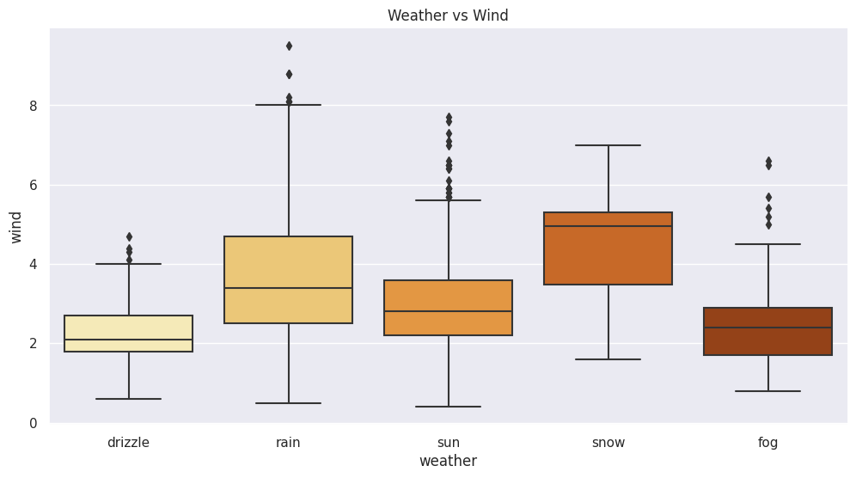
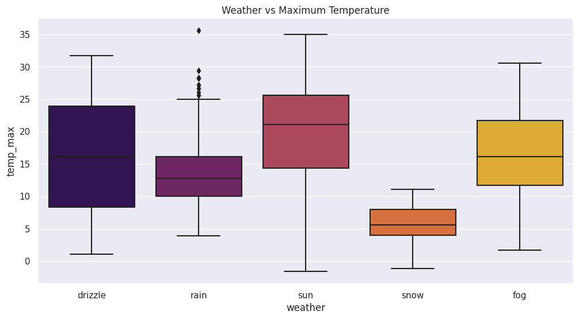
Box Plot Comparisons

Slide 15
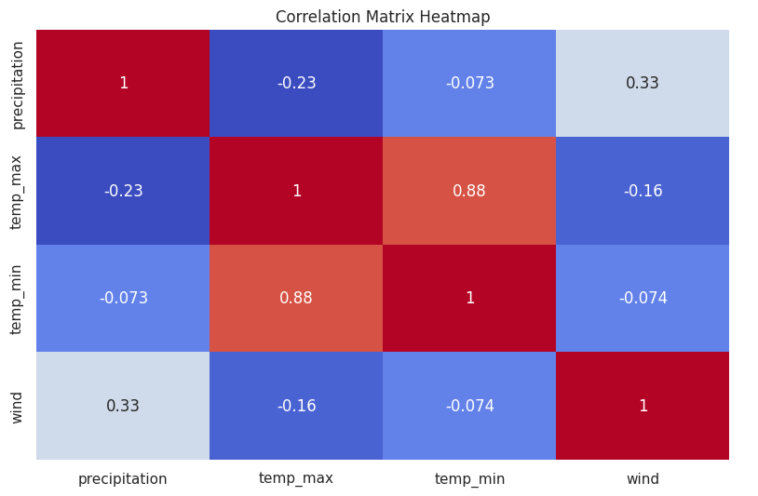
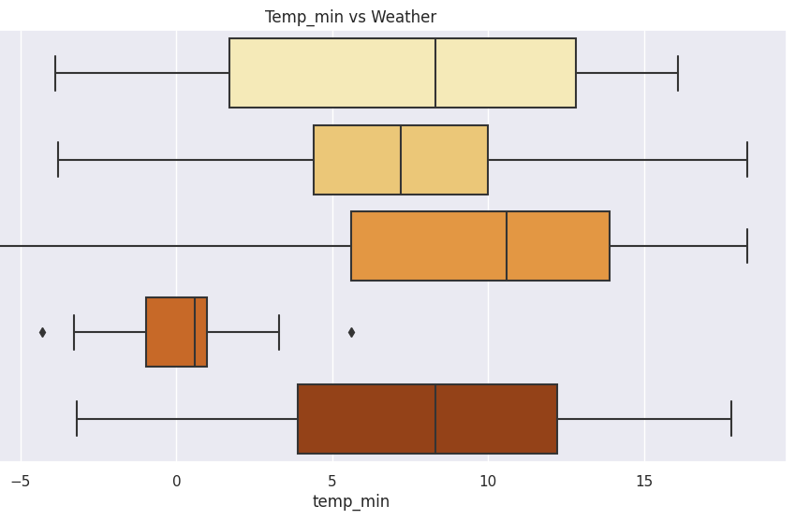
Box Plot (Continues)

Slide 16
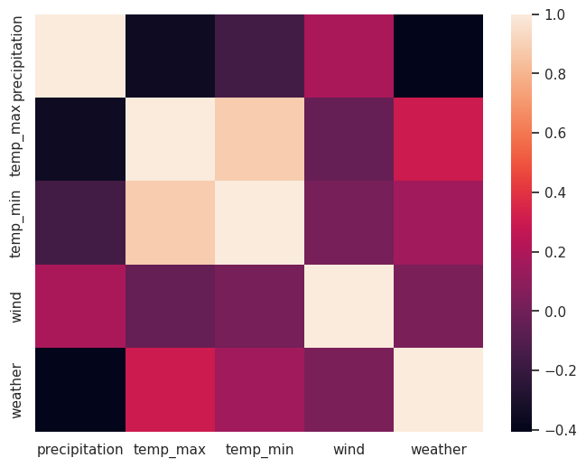
Results/Graphs

Slide 17
Overall Progress
.
Machine Learning Algorithms | Accuracy Score
K-Nearest Neighbour | 75.0
Support Vector Machine | 77.42
Gradient Boosting Classifier | 83.87
Extreme Gradient Boosting Classifier | 83.06
Random Forest Classifier | 83.06
Artificial Neural Networks | 88.71

Slide 18
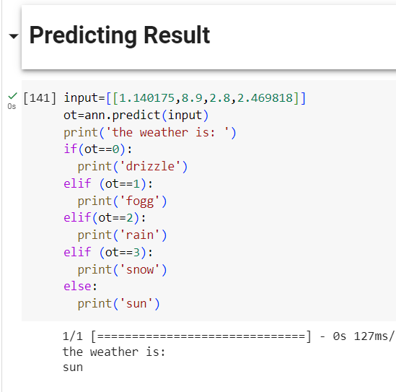
Results/Graphs

Slide 19
Originality
As per the information I gather, different algorithms gave the best accuracy rates for different datasets.
Artificial Neural Network (ANN) gives the best accuracy rate out of all different algorithms (as of now) for one dataset as I gathered in research papers.
As my research, in future technology Polar Orbiting satellites provide the best forecasting for the long term in prediction of weather.

Slide 20

Analytical Skills
Libraries used :
Matplotlib
Seaborn
Scipy
Missingo
sklearn
Pandas
Warnings
Keras
Tensorflow
RanndomForestClassifier

Slide 21
Analytical Skills (Continued)
Machine learning algorithms such as KNN, SVM, GBC, XGB, RFC and ANN had been used.
As mentioned in progress slide, ANN gave the best accuracy rate among those.
ANN can handle high-dimensional input makes them a powerful tool.
By using ANN, the prediction of weather will be accurate.

Slide 22

Design Contents

Slide 23
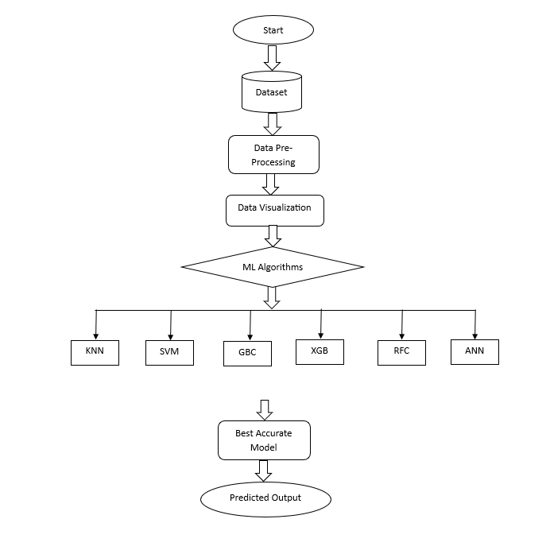
Architecture Design

Slide 24
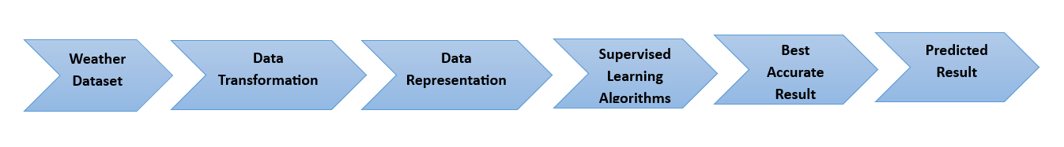
Detailed Design

Slide 25
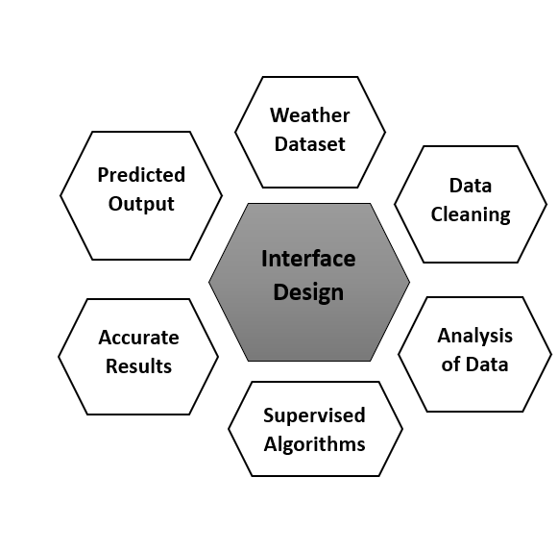
Interface Design

Slide 26

Objectives Achieved
Predicting the best accuracy rate is important and helpful for formers, navy officers and astronauts for their work.
Out of those algorithms, ANN gave the best accuracy rate.
Because ANN have the ability to learn complex patterns, noisy data and incomplete dataset.

Slide 27
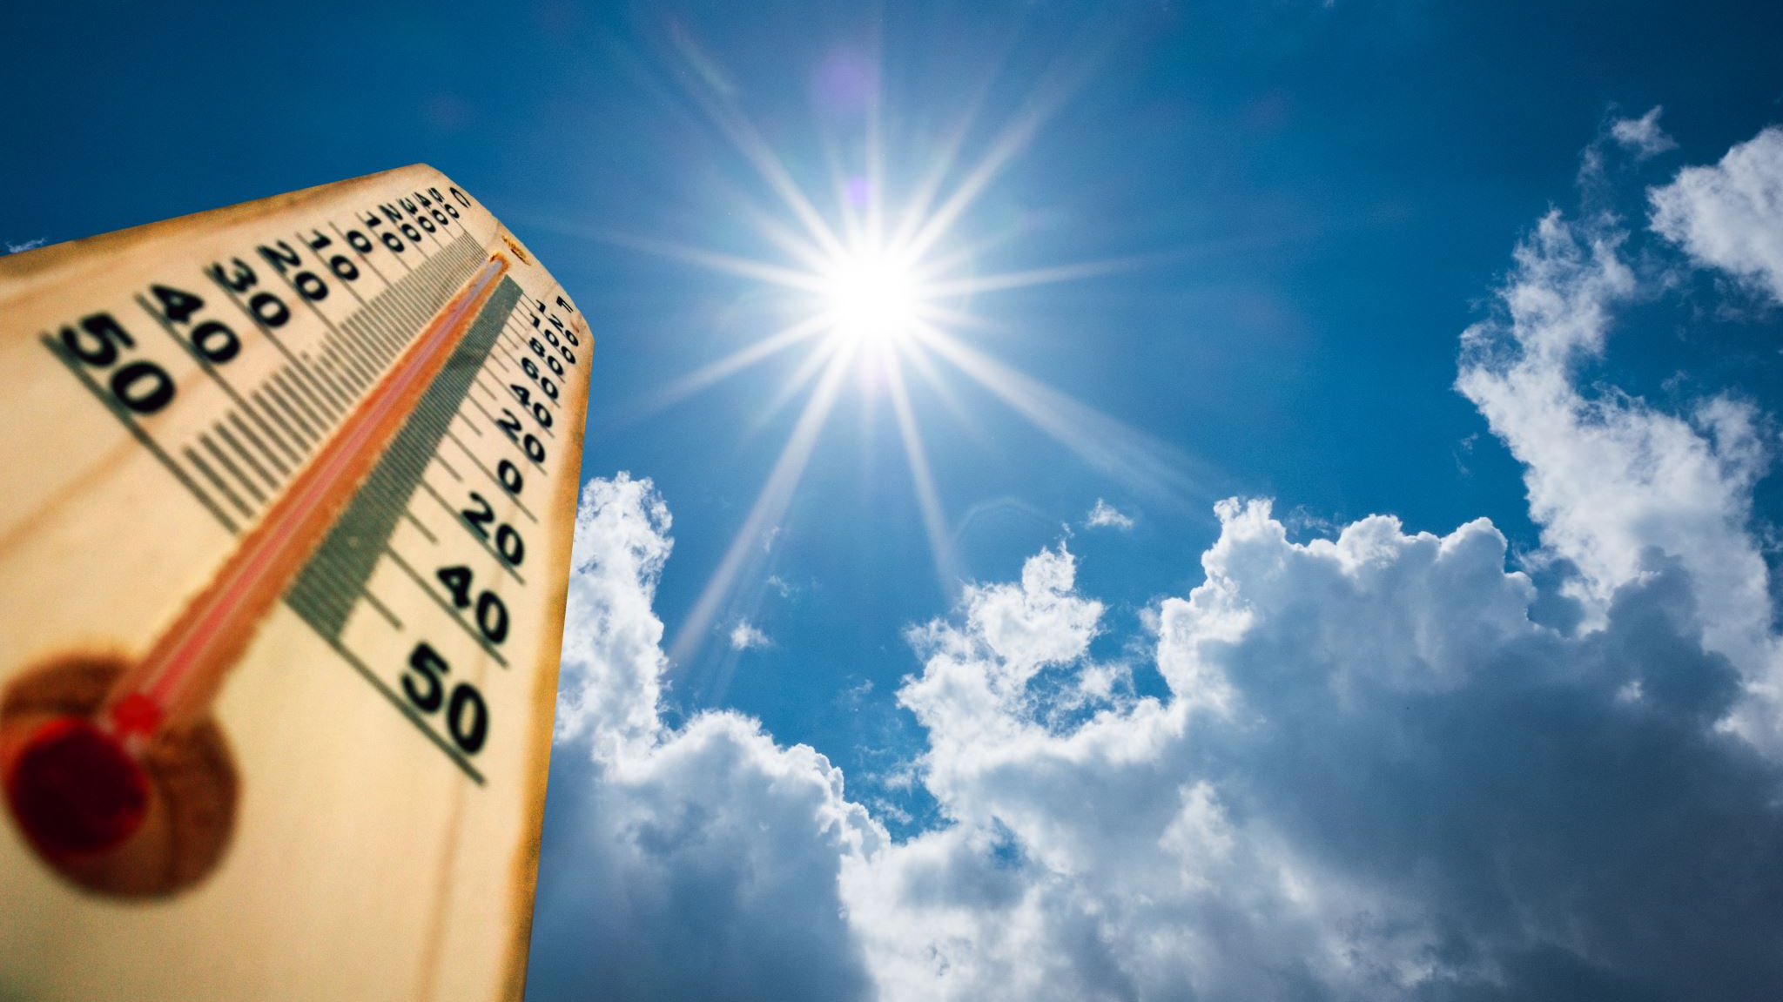
Conclusion
Based on the dataset that was given; the machine learning algorithms will predict which type of weather condition it is.
Here, out of these algorithms, ANN gave the best accuracy rate, and it is used in prediction result.

Slide 28

Thank You

